Slide 1

Create a simple machine learning web app for Heart Disease prediction
SDSC6004 Group Project
Professor: Dr ZHANG Zijun
Group member: DONG Chenxi (56563608)

Slide 2

Outline
Introduction
Data
Concepts (Methods)
Implementation-Construct the Web App
Web App Demonstration
Results
Pros and Cons
Future Work

Slide 3
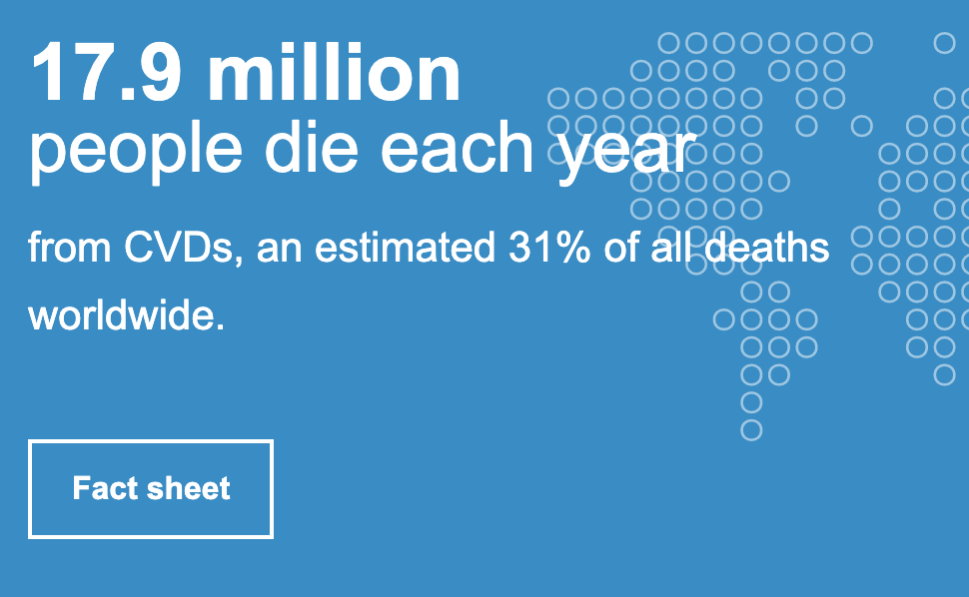

Introduction
Heart Diseases (CVDs)—dangerous
Many risk factors
Need fast and sensible early diagnosis
Machine learning Techniques
UCI dataset (14 attributes)
Why Web App? Interactive User Friendly Prototype

Slide 4
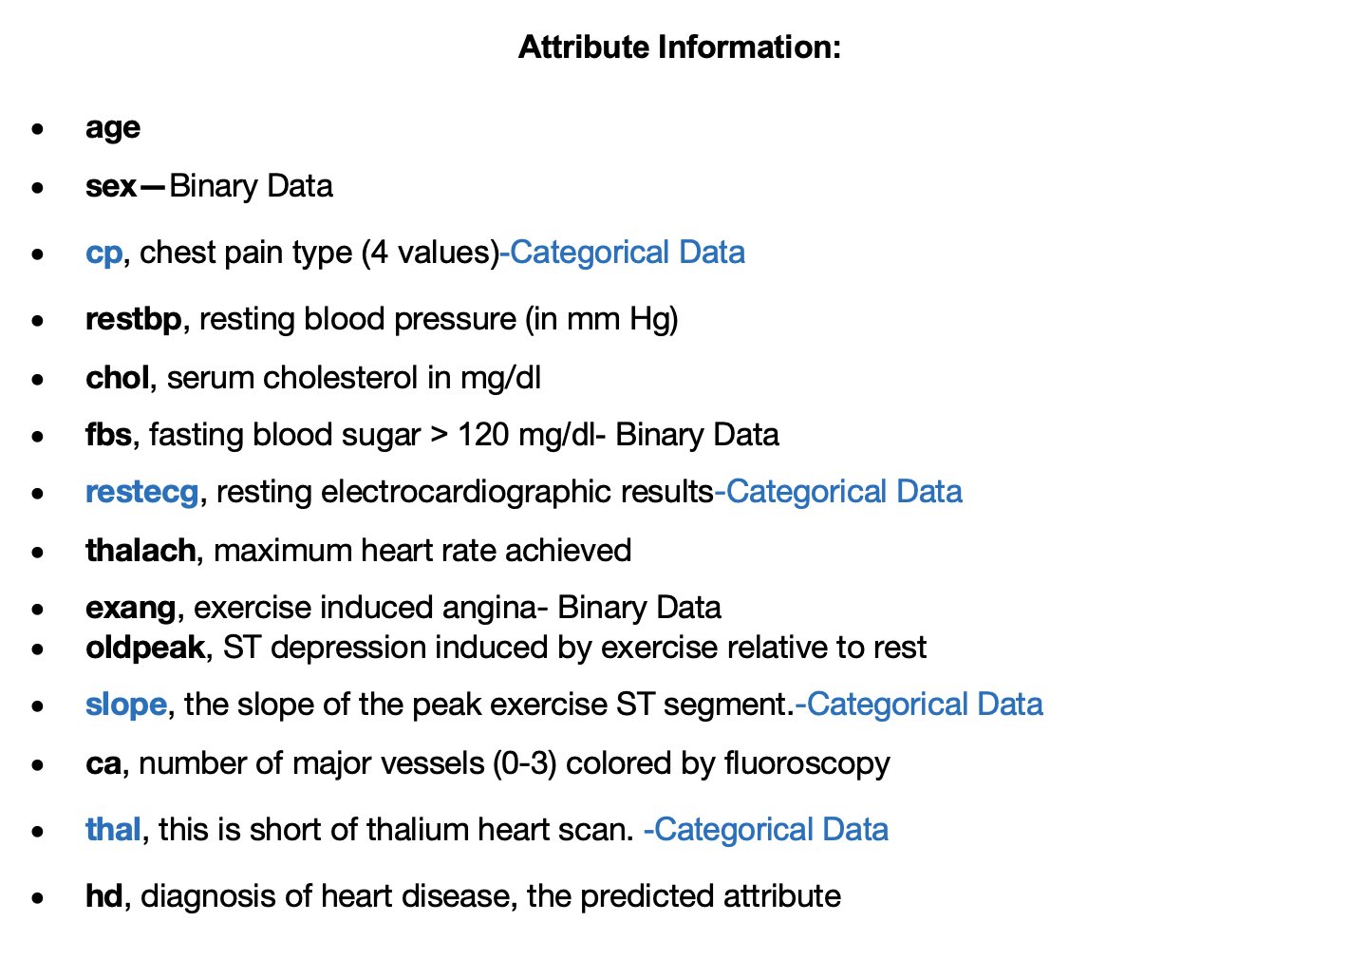
2.1 Data Briefing
Source: UCI (Kaggle)
Attributes:
14 Attributes
13 Factors
1 Prediction Object (hd) hd=0: No heart disease hd=1: Heart disease
Data type:
7 Categorical data (3 Binary)
6 Numerical data
Data Bank Size: 303
No Missing Value

Slide 5
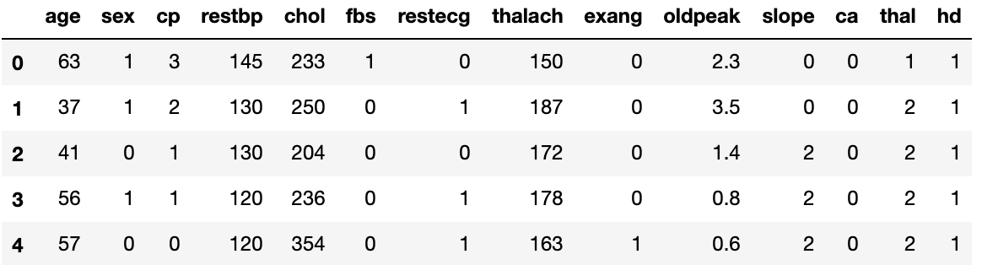
2.2 Data Briefing - Sample
Target: hd (Binary Data)---Response
hd=0: No heart disease hd=1: Heart disease

Slide 6

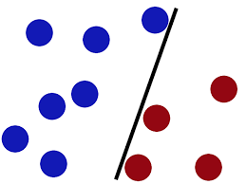

3.1 Concepts---Models
Classification Problem (hd=0 or hd=1)
Suitable Models:
Logistic Regression
SVM
Decision Tree
Web App contains all 3 models

Slide 7
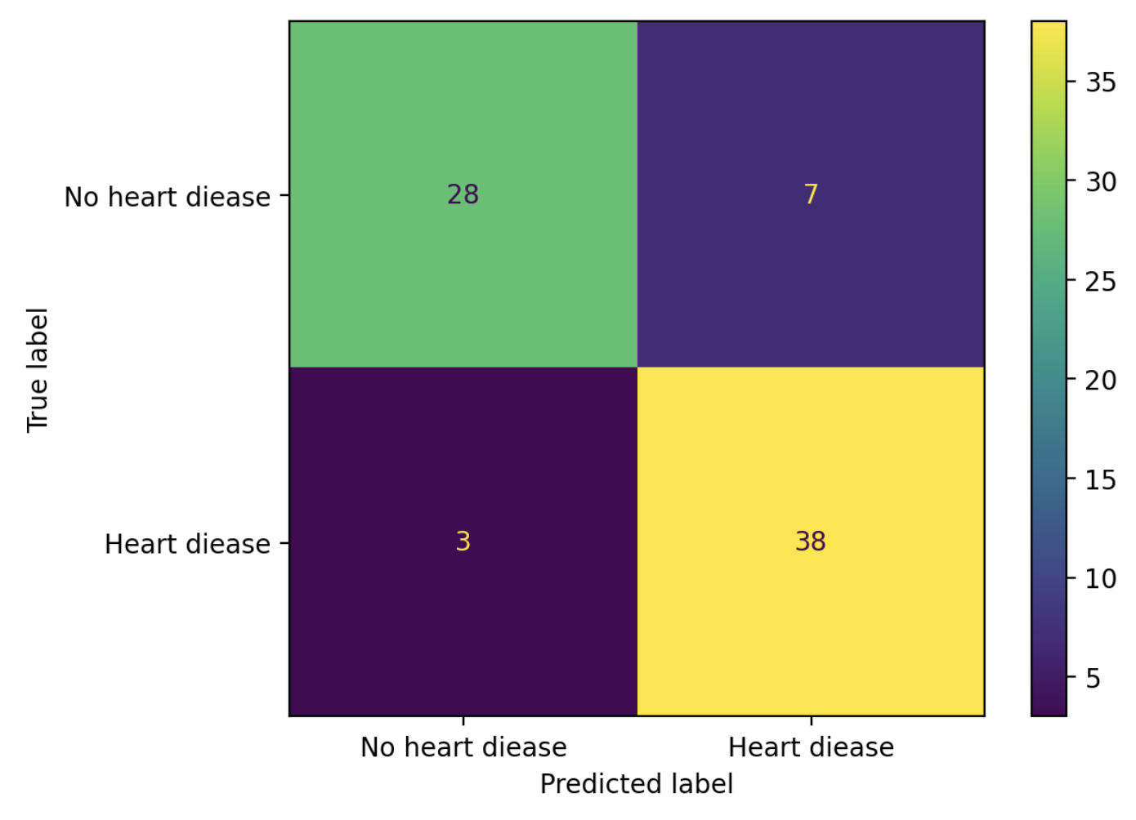
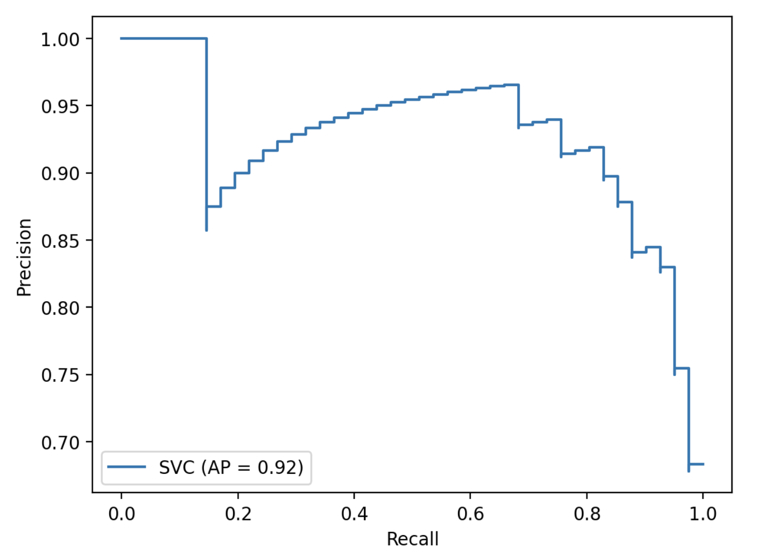
3.2 Concepts—Tuning, Results and Evaluation
Model Tuning (User input or slider)
Kernel type, Kernel Coefficient, Tree Depth, Maximum Iterations, etc.
Results
Confusion Matrix
Display (Accuracy, Precision, Recall)
Evaluation
ROC Curve (Check AUC value)
Precision-Recall Curve (Check AP value)

Slide 8

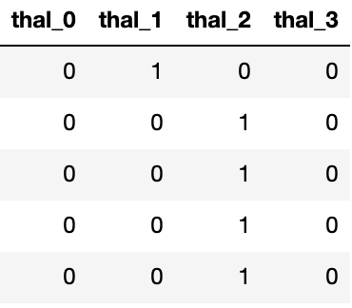
4.1 Implementation-Construct the Web App
Tools: Python Streamlit
Steps:
Main page and Tuning sidebar
Define the function: load, split (test-size by default 0.25)
Process data: One-hot encode the categorical data 'cp','restecg','slope','thal’ e.g. ‘thal’=0, 1, 2, 3

Slide 9
4.2 Implementation-Construct the Web App
Steps:
Built 3 modules for: Decision Tree, Logistic Regression and SVM.
Built the visualization module to display the results:
Confusion Matrix
ROC Curve (Check AUC value)
Precision-Recall Curve (Check AP value)
Test: Load data, train model, show results, evaluate model.

Slide 10
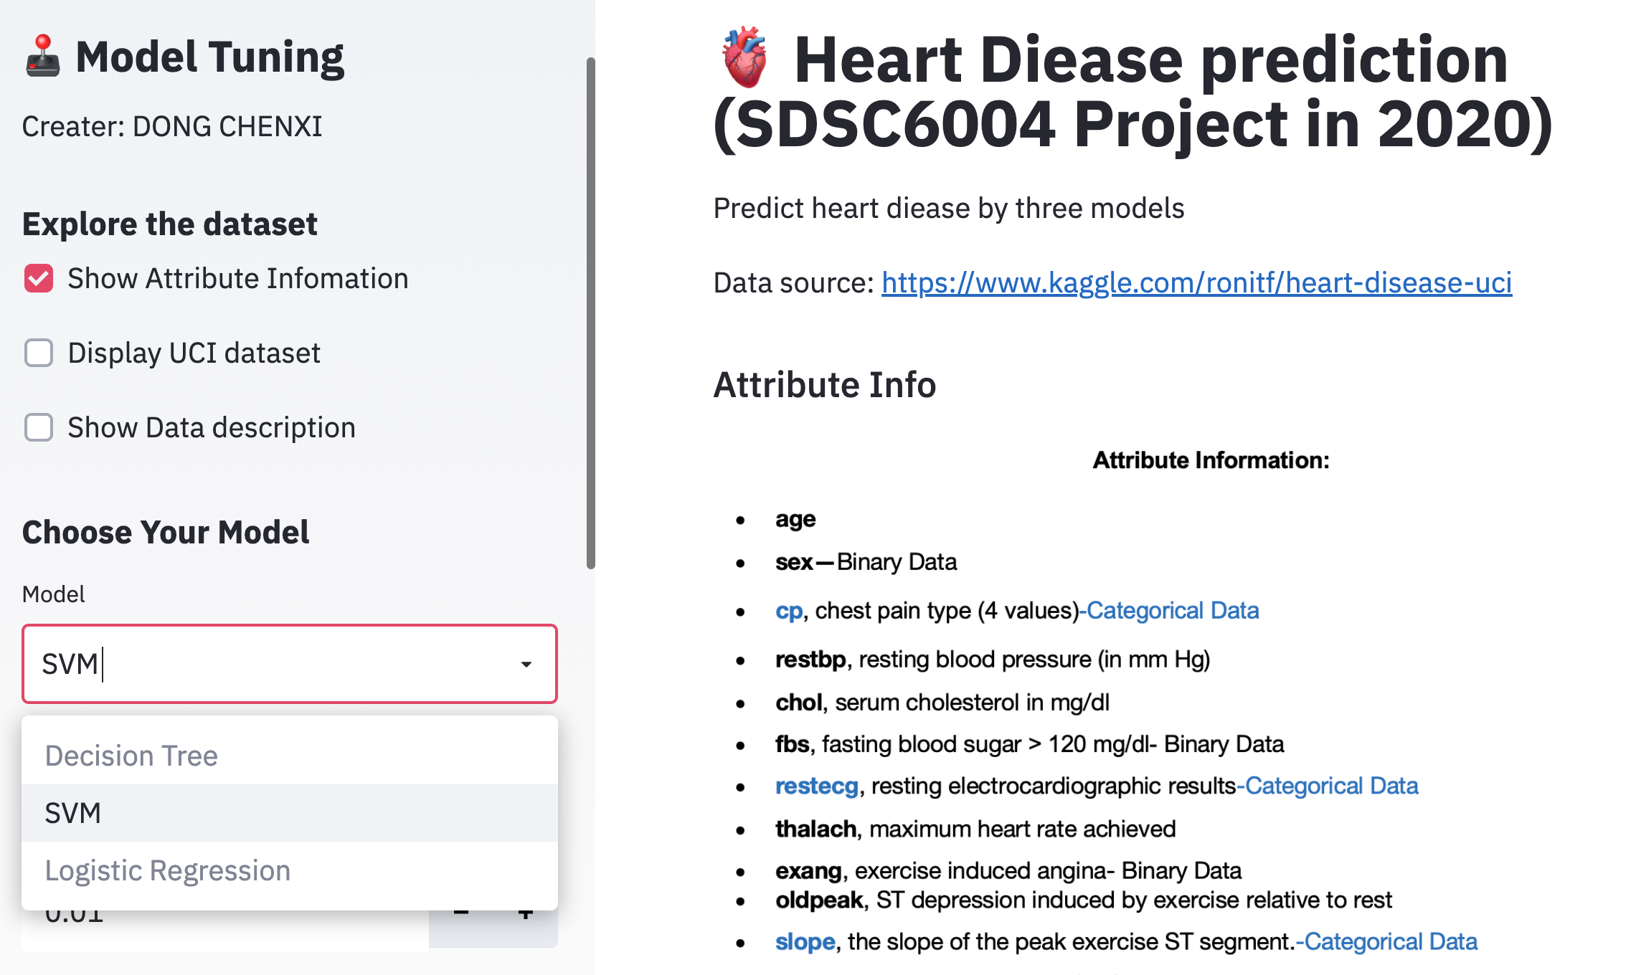
5.1 Web App Demonstration-Sidebar and main page

Slide 11
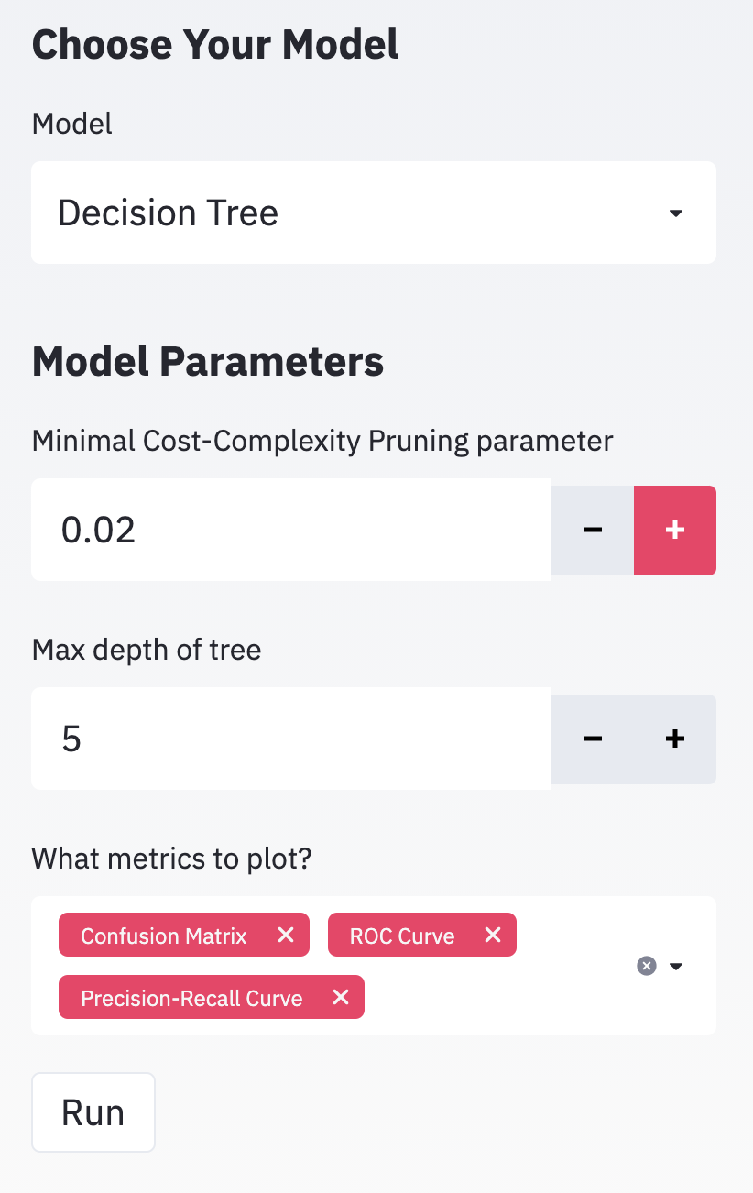
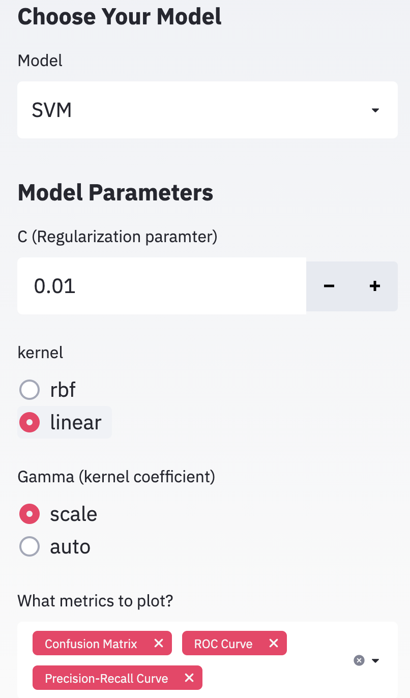
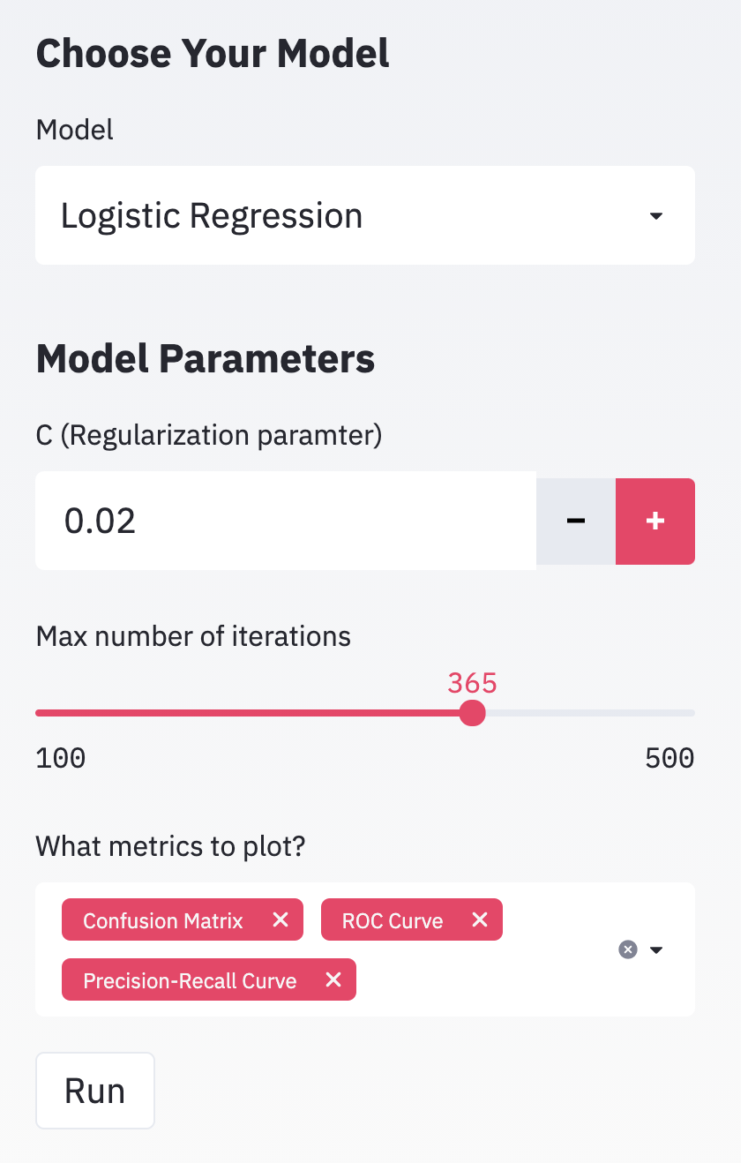
5.2 Web App Demonstration-Adjust Parameters

Slide 12
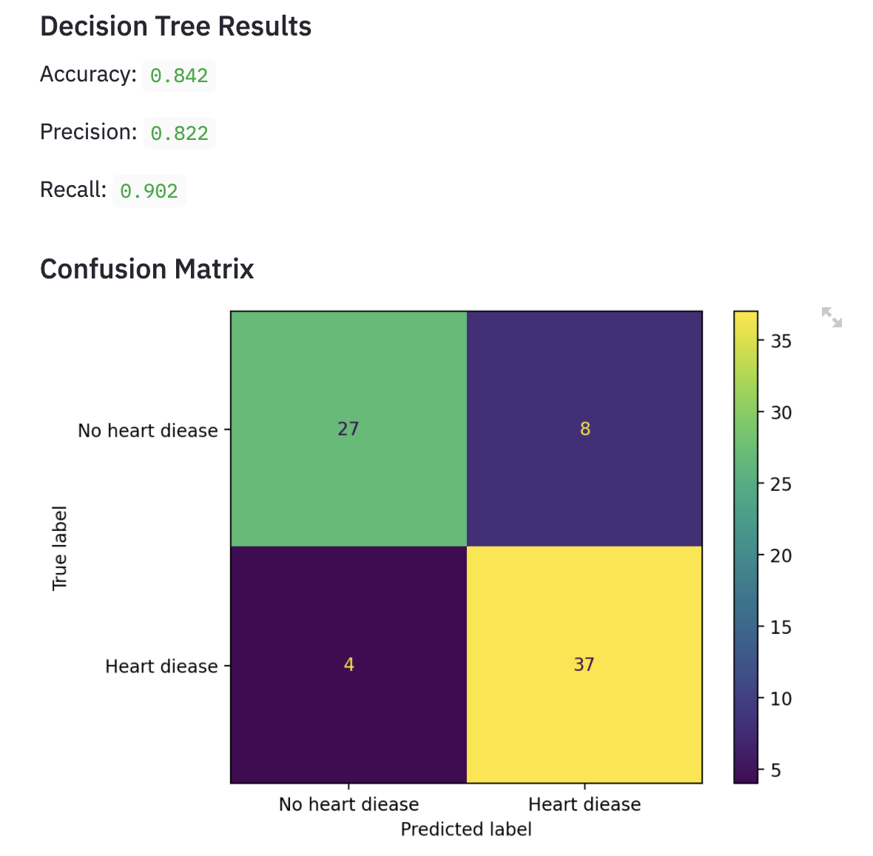
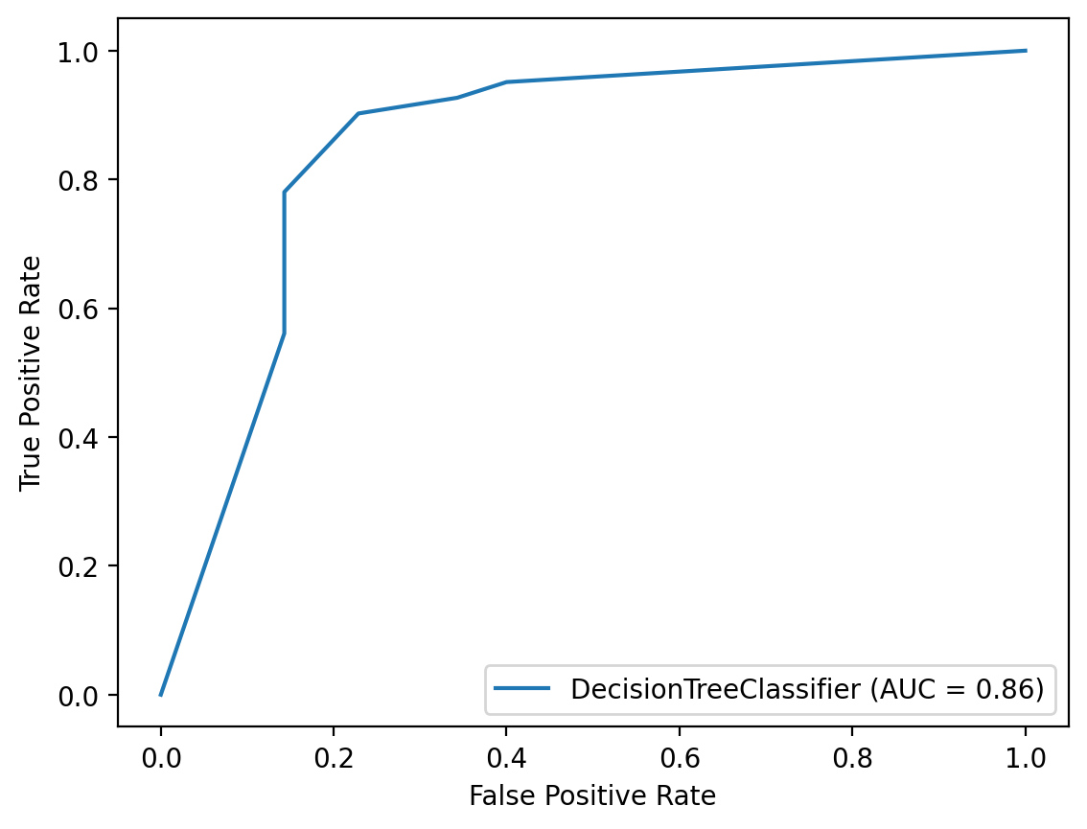
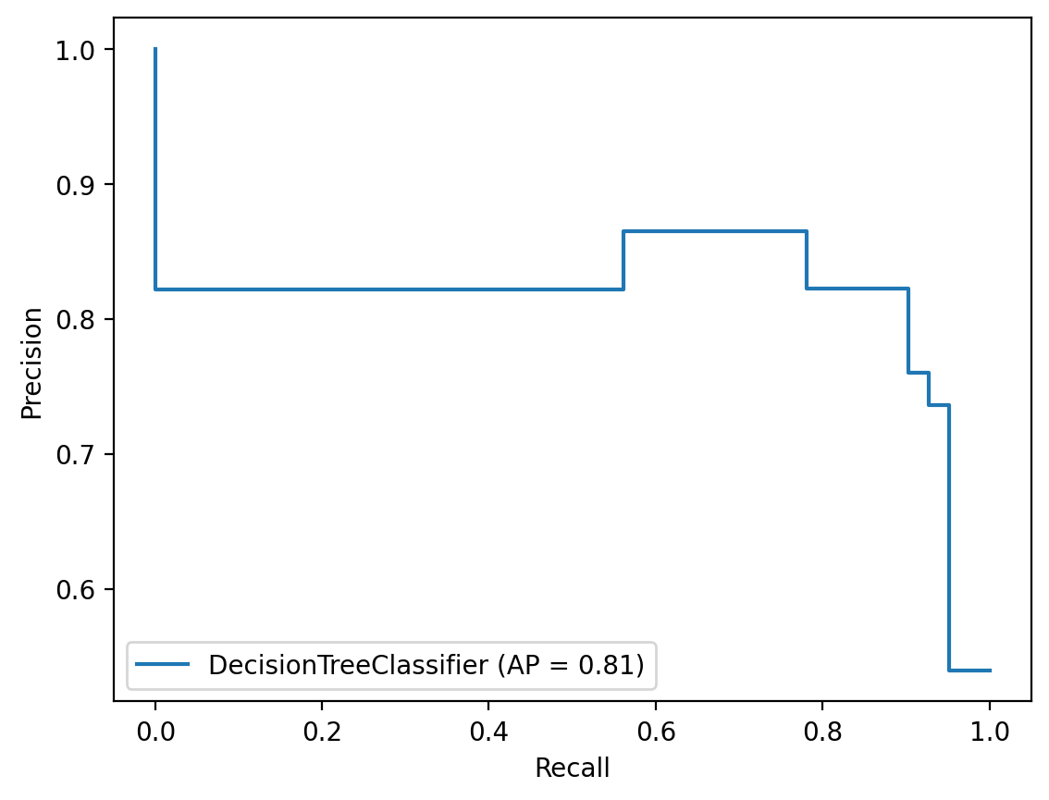
5.3 Web App Demonstration-Display the results

Slide 13
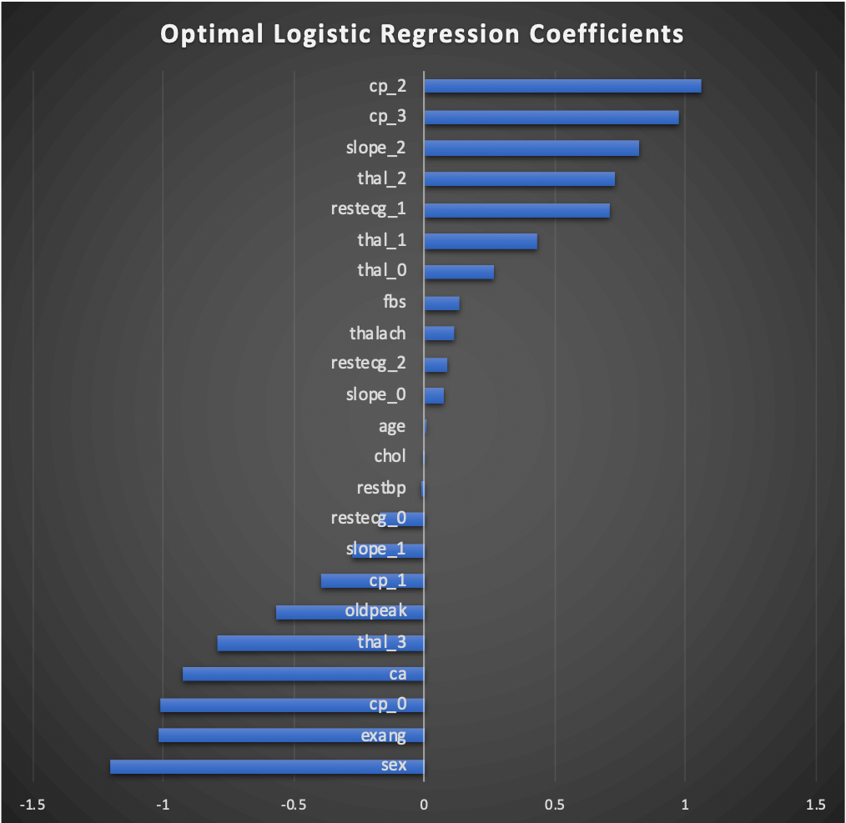
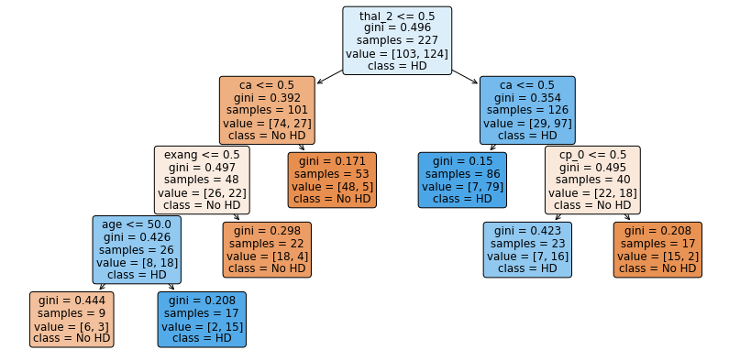
5.4 Web App Demonstration-Display the results

Slide 14
6.1 Results
All Performs good
Logistic Regression and Decision Tree better
Classifier output quality good:
By ROC curve: area under the curve (AUC) value close to 1
By Precision-Recall curve and Average precision (AP) value also close to 1
Model | AUC | AP
Logistic Regression | 0.86 | 0.81
SVM | 0.94 | 0.93
Decision Tree | 0.86 | 0.81

Slide 15
6.2 Results- The top factors for heart disease
Good indicator for heart: gender, exang, cp_0, ca.
Bad indicator for heart: cp_2,cp_3,slope_2,thal_2.
Conclusion:
In this dataset, Female have more risk than male for heart disease.
Chest pain(cp) could be a significant signal for heart disease.
Exercise(exang) can help you avoid heart disease.
Thalessemia result of 'reversable defect‘ increase the risk for heart disease.
The larger the slope of the peak exercise ST segment, the more chance it diagnosed heart disease.

Slide 16

7. Pros and Cons
Pros:
Easy to use and understand
Interactive
Operatable
Fast prototype
Cons
Test-size small
Streamlit limitation (packages and functions)
Perhaps miss better models
Data size small

Slide 17

8. Future Work
Increase test-size (now is 25%)
Add a “Input and Predict” Module Allow Users to input their personal data and show the prediction result.
Add Data Bank Size
Try more models (e.g. Random Forest)

Slide 18

Q&A

